Slide 1
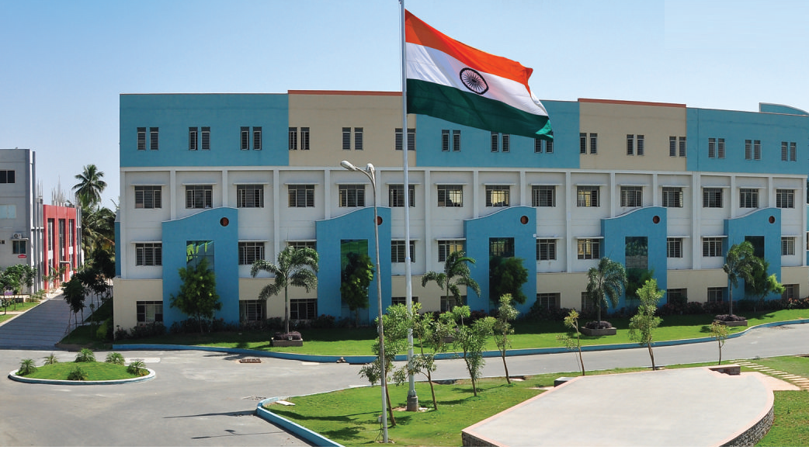
SRI ESHWAR COLLEGE OF ENGINEERING academic year: 2017-18 department : civil engineering section : 3 year
DESIGN PROJECT REVIEW – 0
Date of review:24/04/2017

Slide 2
Planning , Analysis and Designing of Locohut
Batch Members
Dinesh kumar . S
Gopinath . T
Idhayavanan. P
Mohan raj . S
Guide Name
Mr. Siva K.P
Asst.Prof/Civil Dept.

Slide 3
Presentation Outline
Abstract
Literature Survey
Need for the study

Slide 4
Abstract of the project
The main objective of this project is to plan, analysis and design an car showroom.
Details
No. of Car displayed: 15 Cars
Type of Roof: Flat Roofing
No.of.Stories: G+3
Location : Pollachi
Its Primary loading conditions will be given by steel using codal provisions IS 800:2007, IS 875 Part 1-5:1987

Slide 5
Literature Survey (Cont’d..)
JOURNAL | American Institute of Steel Constructions
TITLE | Parking structure with post tensioned deck, Effects of slab post tensioning on supporting steel beams in steel framed parking decks structures
AUTHOR(S) | Bokota, John F.(1988), Sharma Bhavna; Harries , Kent A .(2008)
INFERENCE | Current trend towards structural steel packing with a ‘pre-stress deck’. In a composite and non composite manner. They conclude that the post tensioning force is carried almost entirely in composite manner (minus effect of shrinkage and elastic short tening).

Slide 6
Need for the study
To built a luxury car showroom for pollachi people promoting urban development.
To make local people convenient to visit high class showroom
To bring a new platform for the car showroom
To built a showroom which is both economical and luxury
Further future work may extended to car and bike showroom

Slide 7
Work Schedule
S.NO | DATE | WORK TO BE DONE | REMARKS
1 | 22.04.2017 | Selection of project title | .
2 | 25.04.2017 | Collection of literatures | .
3 | 28.05.2017 | Planning | .
4 | 20.06.2017 | Analysis by E-TABS | .
5 | 25.07.2017 | Designing by E-TABS & Manual | .
6 | 03.08.2017 | Generation of report | .
7 | 15.08.2017 | Preparation of book | .
8 | 30.08.2107 | Submission of book | .

Slide 8
Queries?

